Slide 1
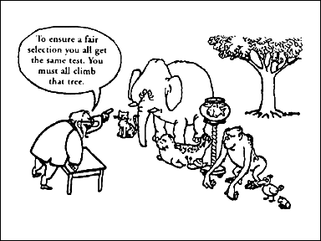
Understanding TABs

Slide 2
TABs
Traits, Aptitudes, and Behaviors (TABs)
Identification of gifted children from varying cultural and economic groups
Ten TABs which have been found through research to be consistently associated with the psychological construct of giftedness

Slide 3
Directions:
While observing the student, please consider the following traits, aptitudes, & behaviors (TABs) associated with the giftedness construct.
Use the scale in the bottom of each box to summarize your evaluation.
Circle the number that best represents this student when compared to others of the same age, experience, or environment; or circle “0” if unobserved

Slide 4
Motivation – Evidence of desire to learn
Demonstrate persistence in pursuing and/or completing self-selected tasks. Tasks may be culturally influenced
Focus motivation on non-school activities rather than school activities
Be an enthusiastic learner of non-school or school related subject matter
Aspire to be somebody, to do something

Slide 5
Interests – A feeling of intentness, passion, concern, or curiosity about something
Demonstrate unusual or advanced interests
In a topic or activity
Be a self-starter
Pursue an activity unceasingly
Be beyond age group in activities/interests
Show concern for local and global interest

Slide 6
Communication Skills – Highly expressive and effective use of words, numbers, & symbols
Demonstrate unusual ability to communicate verbally
Physically, artistically, or symbolically
Use particularly apt examples, illustrations, or elaborations
Use this ability in or out of the classroom

Slide 7
Problem-Solving Ability – Effective, often inventive, strategies for recognizing & solving problems
Use effective & often inventive strategies for recognizing & solving problems
Be able to change strategies if selected solution doesn’t work
Create new designs, invent
Use this ability in or out of the classroom

Slide 8
Humor – Brings two heretofore unrelated ideas or planes of thought together in a recognized relationship
Have keen sense of humor which could be gentle or hostile
Have exceptional sense of timing
Demonstrate unusual emotional depth

Slide 9
Inquiry – Questions, experiments, explores
Ask unusual questions for age
Play around with ideas
Demonstrate extensive exploratory behaviors directed toward eliciting info. about materials, devices, or situations

Slide 10
Leadership – Displays leadership among his/her peers
Be quick to help others
Carry out responsibilities well
Lead others on the playground or in other unconstructed situations (could be in a negative or positive way)

Slide 11
Reasoning – Logical approaches to figuring out solutions
Make generalizations
Use metaphors & analogies
Think things through in a logical manner
Think critically
Think things through and come up with a plausible answer

Slide 12
Imagination/Creativity – Produces many ideas; highly original
Show exceptional ingenuity in using everyday materials
Have wild, seemingly silly ideas
Solve problems through non-traditional patterns of thinking
Produce ideas fluently/ flexibly
Be highly curious
Display figural or verbal creativity

Slide 13
Insight – Quickly grasps new concepts and make connections; senses deeper meanings
Show sudden discovery of correct solution following incorrect attempts based primarily on trial and error
Display high ability to draw inferences
Appear to be a good guesser
Possess heightened capacity for seeing unusual and diverse relationships
Integrate ideas and disciplines

