Slide 1
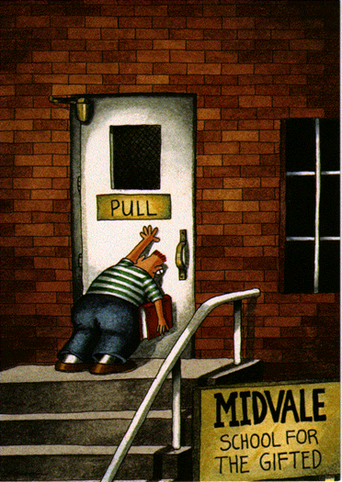
Gifted
Children:
A Special Variety
Justine Cauley, Miranda Manley, and Mark Berg
Based on a Presentation By:Julie Williams

Slide 2

Genius Child
This is a song for the genius child
Sing it softly, for the song is wild
Sing it softly as you ever can-
Lest the song get out of hand.
Nobody loves a genius child.
Can you love an eagle
Tame or wild?
Can you love an eagle
Wild or tame?
Can you love a monster
of frightening name?
Nobody loves a genius child.
Kill him - and let his soul run wild!
- Langston Hughes

Slide 3

Who are the Gifted?
Someone who shows, or has the potential for showing, an exceptional level of performance in one or more areas of expression:
About 2.5% of the student population
However, “No matter how gifted, children do not develop their gifts without a parent or supporter behind them encouraging, stimulating, and pushing” (Winner, 1996).
Intellectual Ability
Creativity
Specific Academic Aptitude
Leadership Ability
Performing/Visual Arts
Notes:
Now quickly think just on your grade level, or at your table…who would you pick to be intellectually gifted? Creatively? SAA? Leader for the good or bad? pva??? I would bet it would be hard to find one person at your table with ALL/MOST traits…its rare. Usually a creatively gifted child varies drastically from a saa—saa is more of a teacher pleaser-depending on the teacher’s style of course!

Slide 4
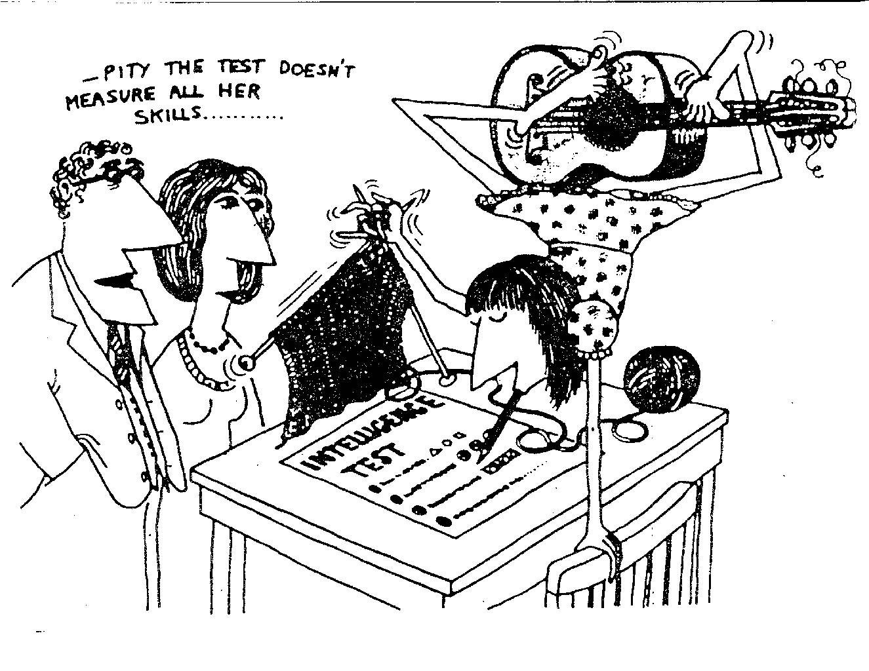
Who are the Gifted?

Slide 5

Do You Know this Student?
Refuses to do homework
Argues with teacher
Always has to be in control
Blurts out answers without raising hand
Turns in messy work; not interested in details
“Keeps” a notebook by stuffing work in backpack
Arrives late because always one or more things HAD to be done
Notes:
If you ask questions, please raise your hand to get my attention and then speak loud enough for everyone to hear your question. I appreciate your help in making this a smooth running and useful program for everyone. Any questions before we get started? … Alright, lets go.

Slide 6
Do You Know this Student?
Easily bored
Critical of self and others
Refuses to hear criticism of self
Emotionally sensitive
Impatient with others when they don’t “get it”
Jokes at inappropriate times
Tells jokes peers don’t understand; may have a weird or zany sense of humor
Difficult to move to another topic

Slide 7
Do You Know this Student?
Never satisfied with their work
Hard time making choices
Gets carried away with details
Always does last minute cramming
CONSTANTLY busies self with something
Checks up on other people’s work
Daydreams
Sneak reading
PROCRASTINATES

Slide 8
Do You Know this Student?
Do You Know this Student?
Above Ave.
Special Needs
Average
Below Ave.
Gifted
Underchallenging classroom Experiences
Are we fostering underachievement?

Slide 9
Does that mean we want you to refer any student that has many of these characteristics?
CERTAINLY NOT!
But we DON’T want you to EXCLUDE ANY students or fail to consider anyone since these ARE characteristics of some gifted students.

Slide 10

How are they identified?
1. Referral
2. Screening
3. Eligibility

Slide 11
MYTH: All gifted children are early readers.
“Early readers are most often gifted;
not all gifted children learn to read early.”
Examples:
Mathematically gifted children
those with ADD/ADHD
those with learning disabilities
culturally diverse children
under-achievers are often visual-spatial
learners as opposed to auditory-sequential learners.
Notes:
They could have gone to a school that had intensive Phonics and Reading instruction at an early age-the will most probably LEVEL out- unless it’ s more than just tremendous “fluency”

Slide 12
MYTH: Gifted students score well on tests of educational achievement!
Many think abstractly and with such
complexity that they need help with concrete study and test taking skills.
They may not be able to select one right
answer because they can see how all the
answers might be correct.
They can be “mappers” or “leapers”
Notes:
Mappers-organized needs to follow a set routine/schedule or process…Leapers-leap from idea to idea to make a connection-no set pattern

Slide 13

MYTH: Gifted children excel in all academic areas.
“Gifted” is generally gifted in language and mathematics, but gifts tend to be domain specific.
Academically gifted can be very different than creatively gifted.
Children can be gifted in one area, not another.
They can also be “twice exceptional,”
gifted with learning disabilities.

Slide 14
More Common Myths…
Gifted students do not need help. If they are really gifted, they can manage on their own.
The social and emotional development of the gifted student is at the same level as his/her intellectual development. (affective education)

Slide 15
And more myths:
Gifted students need to serve as examples to others, and they should always assume extra responsibility.
Gifted students are naturally creative and do not need encouragement.
The primary value of a gifted student lies in his/her brain power.

Slide 16
Common Characteristics of
Gifted and Talented Students
Learns quickly and easily
Able to use abstract thought and critical reasoning
Dislike repetition
Introverted and happy
Introverted and depressed
Become bored and frustrated
        Exhibit verbal proficiency
        Organizational Problems
  Have a high energy level
Dominate discussions
Difficulty with listening skills
    Becomes frustrated with inactivity and lack of challenge
Notes:
These are pretty self explanatory. Again these are just examples of “common”- which means they MAY exhibit these char. I’ll touch on some of them, not all …emphasizing the parts where giftedness can overlap with other disorders such as ADD and ADHD.

Slide 17
Be highly sensitive
Concerns about death
Be acutely perceptive
Fear failure
Feel frustrated
Disrupt class routine
Perceived as stubborn or uncooperative
Resist interruptions or schedules
Be extremely persistent
Aim at perfection
Insomnia
Excessive worrying
Be unusually vulnerable
Perceived as immature
Exhibit unusual emotional depth and intensity
Demonstrates multiple over-excitabilities
At a young age, questions death and the unknown
Be confused if thoughts and feelings not taken seriously
Concentrate on tasks of high interest for extended periods of time

Slide 18
Exhibit independence and nonconformity
Challenge and question indiscreetly
Exhibit rebellious behavior
Heightened self-awareness
Relate more to older
children and adults
Social isolation
Low self-esteem due to seeing differences from peers as bad
Seen as a “show off”
Use humor inappropriately
or to attack others
Frustration when humor
not understood
Keen sense of humor
Possess unusual imagination
Highly creative
Seen as “weird”
Notes:
Osborne, Julia. “Assessing Gifted Children.” Orig. Published in Understanding Our Gifted. Accessed 5/24/04 from <http://www.hoagiesgifted.org/assessing_gifted.htm>.
Azpeitia, Lynne, M.A. And Mary Rocamora, M.A. “Misdiagnosis of the Gifted.” Rocamora School Inc. Originally published in the MENSA Bulletin, November 1994. Accessed 5/24/04 from <http://www.rocamora.org/Gifted.html>.
Coleman, Mary Ruth. “The Identification of Students Who Are Gifted.” ERIC Clearninghouse on Disabilities and Gifted Education. Accessed 5/24/04 from <http://www.hoagiesgifted.org/eric/e644.html>.
Silverman, Linda Kreger, Ph.D. “What is Giftedness.” Gifted Development Center. Accessed 5/24/04 from <http://gifteddevelopment.com/Articles/What%20is%20giftedness.html>.
“Characteristics of Gifted Children and Talented Children and Possible Associated Problems.” Queensland Association for Gifted and Talented Children, Inc. Accessed 5/24/04 from <http://www.qagtc.org.au/charprob.htm>.

Slide 19
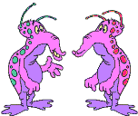
Asks the questions
Is mentally and physically involved if they like the topic
Is highly curious
Plays around, yet tests well
Beyond the group
Already knows
1-2 reps for mastery
Enjoys adults
Enjoys learning - but may hate school
Good guesser - draws on vast information store
Bright
vs.
Gifted
Knows the answers
Is attentive
Is interested
Works hard
Top group
Learns with ease
6-8 reps for mastery
Enjoys peers
Enjoys school
Good memorizer

Slide 20
Special Needs of Gifted Students
*Depth
*Complexity
*Acceleration
*Choice
*Opportunities to express creativity
Attention to social/emotional
development (Counseling)
*In their area/s of giftedness

Slide 21
What “CAUSES” Giftedness?
Nature?
Nurture?
VS.
Experience?
Biological Factors?
Social Factors?
No single factor “causes” giftedness!

Slide 22
Why Do We Need
Gifted Education?
Gifted learners must be given stimulating educational experiences appropriate to level of ability.
Only 1/2 of gifted learners receive education appropriate to their needs.
Gifted education programs fulfill both individual and societal needs.

Slide 23
“All of us do not have equal talent, but all of us should have an equal opportunity to develop our talent.”
- President John F. Kennedy

Slide 24
Sources
    Jones, Geoffrey (1990). Personal Computers Help Gifted Students Work Smart. ERIC EC Digest, E483, 1990. 15 May 2004. http://www.kidsource.com/kidsource/content/pcgifted.html
    National Association for Gifted Children (2004). NAGC Parent Information. 20 May 2004. http://www.nagc.org/ParentInfo/Index.html
    Network for Instructional TV, inc. (2001). Meeting the Need of Gifted Students in the Regular Classroom. 15 May 2004. http://www.teachersfirst.com/gifted/strategies.html
    Province of British Columbia (2001). Gifted Education – A Resource Guide for Teachers. 15 May 2004. http://www.bced.gov.bc.ca/specialed/gifted/strategies.htm
    Winebrenner, Susan, & Berger, Sandra (1994). Providing Curriculum Alternatives to Motivate Gifted Students. ERIC Digest, E524, Jun 1994. 15 May 2004.http://www.kidsource.com/education/motivategifted.html

Slide 25
Sources continued…
Azpeitia, Lynne, M.A. And Mary Rocamora, M.A. “Misdiagnosis of the Gifted.” Rocamora School Inc. Originally published in the MENSA Bulletin, November 1994. Accessed 5/24/04 from <http://www.rocamora.org/Gifted.html>.
“Characteristics of Gifted Children and Talented Children and Possible Associated Problems.” Queensland Association for Gifted and Talented Children, Inc. Accessed 5/24/04 from <http://www.qagtc.org.au/charprob.htm>.
Coleman, Mary Ruth. “The Identification of Students Who Are Gifted.” ERIC Clearninghouse on Disabilities and Gifted Education. Accessed 5/24/04 from <http://www.hoagiesgifted.org/eric/e644.html>.
Osborne, Julia. “Assessing Gifted Children.” Orig. Published in Understanding Our Gifted. Accessed 5/24/04 from <http://www.hoagiesgifted.org/assessing_gifted.htm>.
Silverman, Linda Kreger, Ph.D. “What is Giftedness.” Gifted Development Center. Accessed 5/24/04 from <http://gifteddevelopment.com/Articles/What%20is%20giftedness.html>.

Slide 26
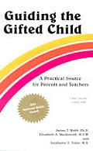
For More Information…
Guiding the Gifted Child: A Practical Source for Parents and Teachers
(James T. Webb, Elizabeth A. Meckstroth, Stephanie S. Tolan)
Raisin’ Brains: Surviving My Smart Family
(Karen L. J. Isaacson)

Slide 27
Smart Girls: A New Psychology of Girls, Women and Giftedness
(Barbara Kerr)
WEBSITES:
Great Potential Press Website
Institute for Educational Advancement Website
Questia Online Library (links to many resources)
National Foundation for Gifted and Creative Children Website
National Association for Gifted Children Web site

